Slide 1
A Survey of South American Lizards Biodiversity and Ecological

Slide 2
Introduction
South America is home to a diverse array of lizard species that play vital ecological roles in the continent's intricate ecosystems. This research explores the fascinating world of South American lizards, highlighting the unique characteristics, habitats, and ecological significance of three remarkable species. Additionally, we examine the threats these lizards face and the conservation efforts in place to protect them.

Slide 3
The Sphaerodactylidae family consists of small geckos known as dwarf geckos These
South America is home to a diverse array of lizard species, belonging to various families and exhibiting a remarkable range of colors, patterns, and behaviors. This article provides an overview of some of the most notable lizard families and species found in South America, including the Green Iguana (Iguana iguana).

Slide 4
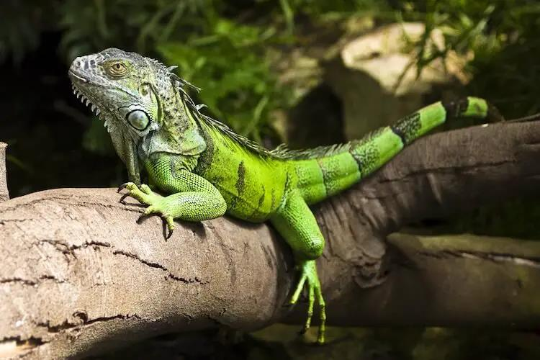

Slide 5
Caiman Lizard Dracaena guianensis
The Caiman Lizard (Dracaena guianensis) is a captivating reptile native to the tropical regions of South America, particularly found in the Amazon Basin and its surrounding areas.

Slide 6
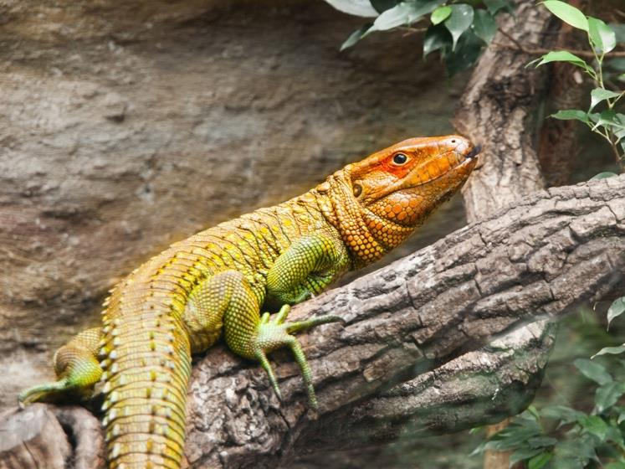

Slide 7
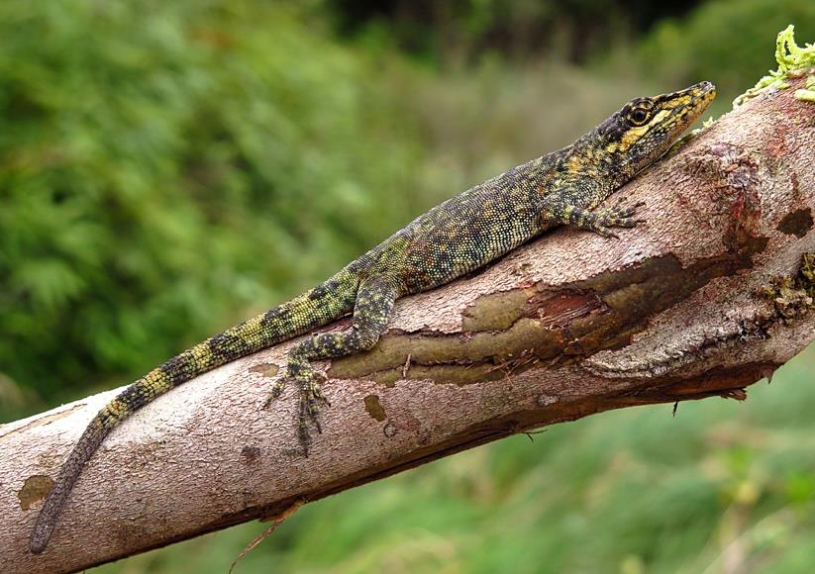

Slide 8
Threats and Conservation
The Green Iguana, Caiman Lizard, and Tepui Lizard are three captivating South American lizard species that showcase the continent's rich biodiversity. These reptiles face various threats, including habitat loss, illegal pet trade, and climate change, which highlight the need for conservation efforts to protect them and their habitats. This essay explores the unique characteristics, ecological roles, and conservation needs of these fascinating lizards, emphasizing the importance of protecting their populations for the health and stability of South American ecosystems.

Slide 9
numerous threats such as habitat loss climate change and illegal trade which necessitate
South American lizards are facing numerous threats, such as habitat loss, climate change, and illegal trade, which necessitate urgent conservation efforts.

